Slide 1
Structural model
Class Diagram

Slide 2
Structural Models
Structural models of software display the organization of a system in terms of the components that make up that system and their relationships
Structural models may be static models, which show the structure of the system design, or dynamic models, which show the organization of the system when it is executing
Create structural models of a system when discussing and designing the system architecture

Slide 3
Class Diagrams
Class diagrams are used when developing an object-oriented system model to show the classes in a system and the associations between these classes
An object class can be thought of as a general definition of one kind of system object
An association is a link between classes that indicates that there is some relationship between these classes
When developing models during the early stages of the software engineering process, objects represent something in the real world, such as a patient, a prescription, doctor, etc.

Slide 4
Domain Model Class Diagram Notation
Class diagram key:
  General class symbol: rectangle with three sections
  Sections convey name, attributes, and behaviors
  Methods (behaviors) not shown in domain model class diagram
  Lines connecting rectangles show associations
  Multiplicity reflected above connecting lines
Domain class objects reflect business concern, policies, and constraints
When moving to design, methods and details of methods are included (design class diagram)

Slide 5
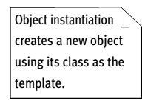
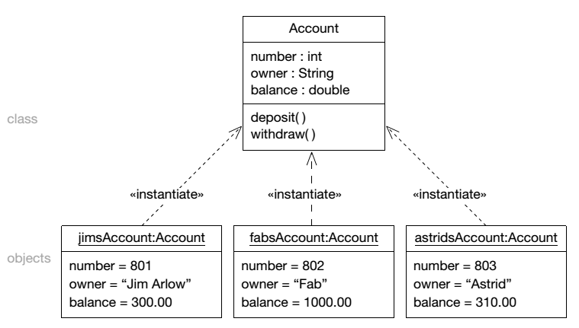
Class and Object Instantiation

Slide 6
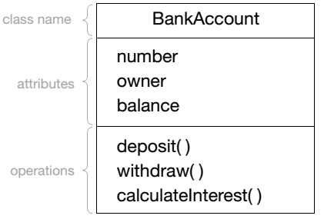
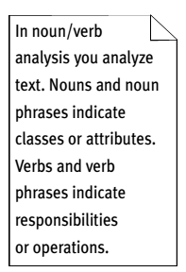
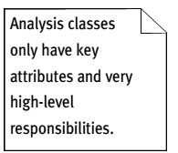
Class as a Template of Objects
Note: Do not include operation part in analysis stage – only in design stage

Slide 7
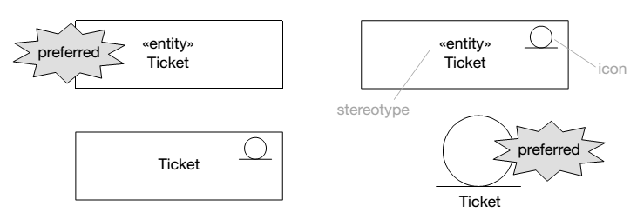
Class Stereotype Syntax

Slide 8
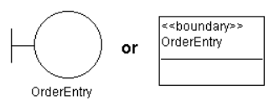
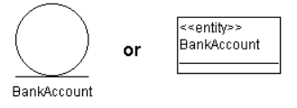
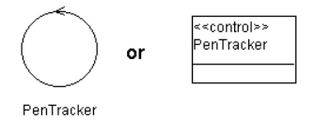
Types of Class Stereotype
Boundary class: interacts with actors outside the system and other objects in the system
Entity class: a passive class i.e. does not initiate interactions on its own, store and manage information, normally persistent data
Control class: coordinate boundary and entity object(s) – collect inform from boundary and dispatch to entity, usually has behavior specific for one use case
Source: https://www.ibm.com/support/knowledgecenter/en/SS6RBX_11.4.2/com.ibm.sa.oomethod.doc/topics

Slide 9
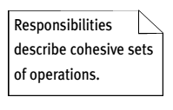
Good Analysis Class
What makes a good analysis class:
its name reflects its intent
it is a crisp abstraction that models one specific element of the problem domain
it maps on to a clearly identifiable feature of the problem domain
it has a small, well-defined set of responsibilities
it has high cohesion
it has low coupling
Note: Our SE course focuses on domain models. Thus, the concepts of high cohesion and low coupling will be elaborated in design stage where we include operations in class diagram.

Slide 10
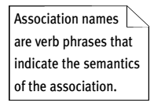
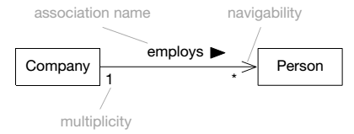
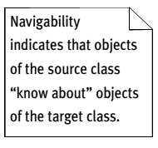
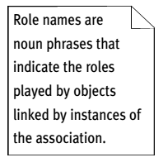
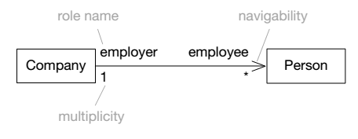
Association
Note: The arrow head in navigability can be ignored in analysis stage
OR

Slide 11
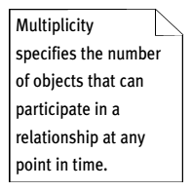
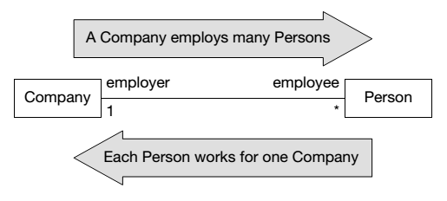
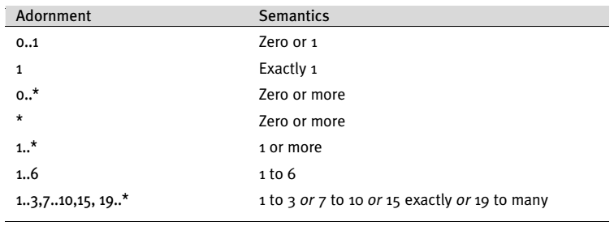
Multiplicity

Slide 12
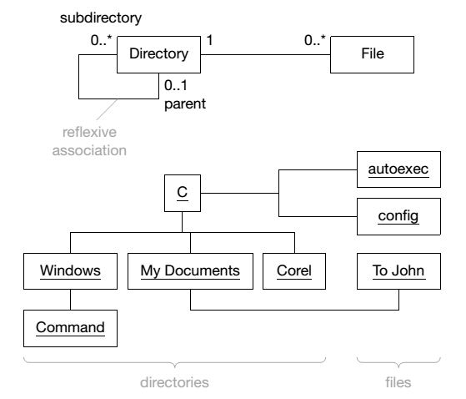
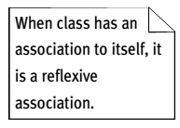
Reflexive Association

Slide 13
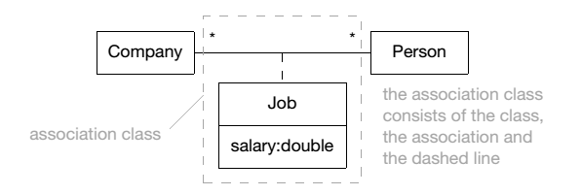
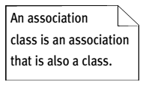
Association Class

Slide 14
Generalization…
Generalization is an everyday technique that can be used to manage complexity
Rather than learning the detailed characteristics of every entity, place these entities in more general classes (animals, cars, houses, etc.) and learn the characteristics of these classes
This allows us to infer that different members of these classes have some common characteristics e.g. square, circle and triangle are shape

Slide 15
Generalization
In modeling systems, it is often useful to examine the classes in a system to see if there is scope for generalization
Do not have to look at all classes in the system to see if they are affected by the change in future
In a generalization, the attributes and operations associated with higher-level classes are also associated with the lower-level classes
The lower-level classes are subclasses inherit the attributes and operations from their superclasses
These lower-level classes then add more specific attributes and operations

Slide 16
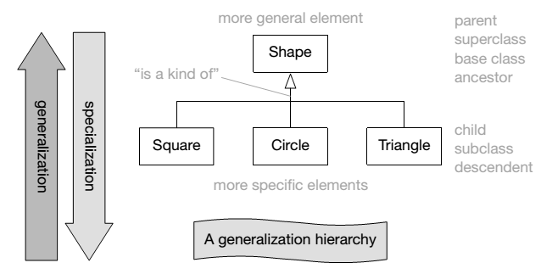
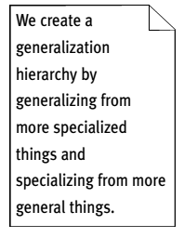
Class Generalization

Slide 17
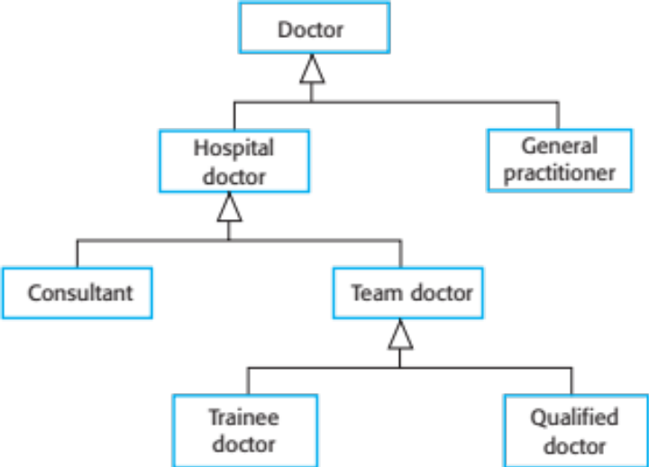
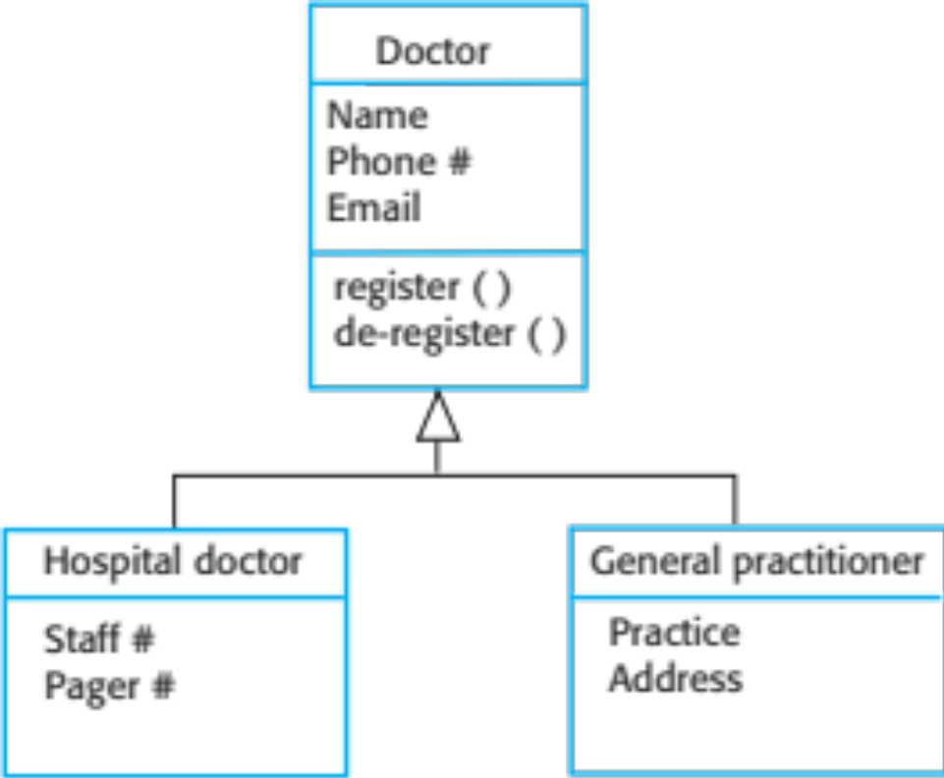
Example: Generalization Hierarchy

Slide 18
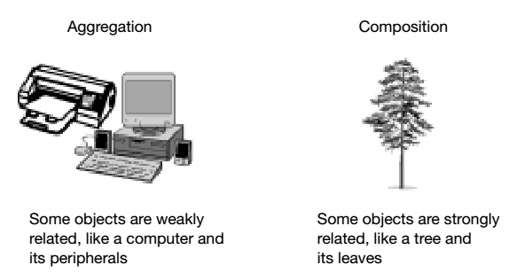
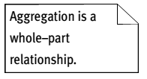
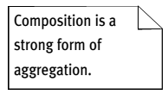
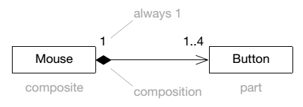
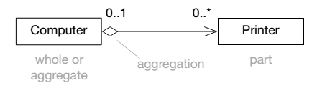
Aggregation and Composition
Note: The arrow head in navigability can be ignored in the analysis stage
Part can exist without whole
Part cannot exist without whole

Slide 19
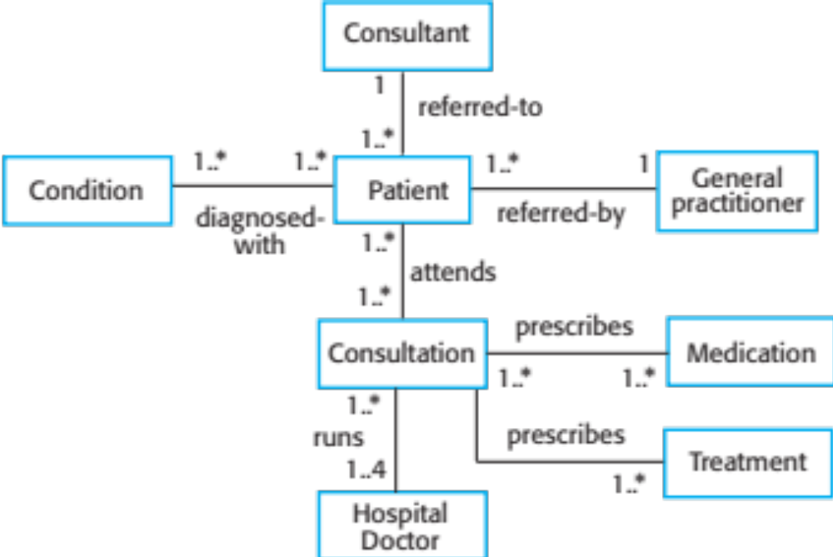
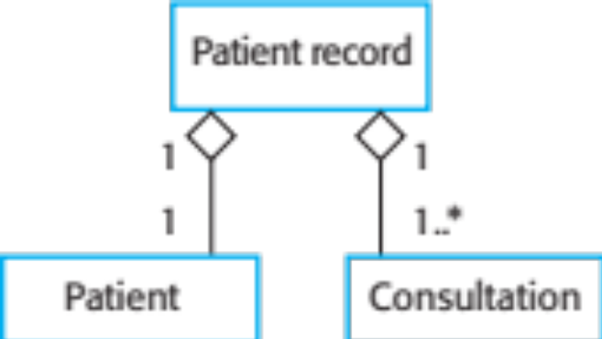
Example: Classes and Associations in MHC-PMS

Slide 20
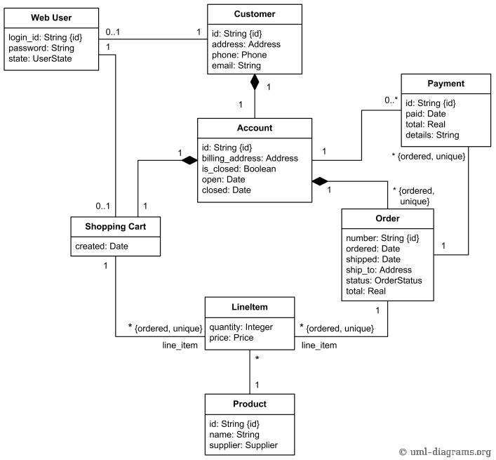
Example: Domain Model for Online Shopping
Note: Stating the type for the attribute is optional in analysis stage
source: https://www.uml-diagrams.org/index-examples.html

